Slide 1

Implementation and Evaluation of Algorithms on Classical and Quantum Computers
Sotiris Loizidis
University of Cyprus, Cyprus
sloizi02@cs.ucy.ac.cy
Thesis Presentation, Cyprus, January 11, 2021

Slide 2
Motivation
Classical Computing has evolved immensely in the last 50 years.
State-of-the-Art supercomputers are reaching Exascale performance.
However, there is a surprising number of problems that conventional machines cannot handle well.
Chemical Substances Simulation.
Quantum Systems Simulation.
Optimization Problems.

Slide 3

Motivation
Quantum Computing is an emerging technology with its scope shifting from academia to commercial applications.
Practical solutions to
real-world problems are
already in the process of
being streamlined
commercially.

Slide 4
Latest Advancements in Real-World Applications
Procedural Game Generation: Algorithms are being developed to produce truly random terrain or effects in games using Quantum Computers.
Volkswagen Quantum Routing: Volkswagen demonstrates real-time optimized routing in buses using Quantum Computers.
Next-Gen Batteries Using Quantum Computers: IBM and Daimler AG researchers simulate molecule formulation in lithium-sulfur batteries using IBM Quantum systems in order to produce the next batteries for electric vehicles.

Slide 5
Challenges
Get acquainted with the basic Quantum Computing Concepts.
Familiarize with the State-of-the-Art frameworks.
Develop a streamlined workflow capable of supporting quantum development in different levels of competence, inspired by Qiskit.

Slide 6
Our Solution (Overview)
We have developed a GitHub repository which encapsulates all the knowledge we have accumulated.
The repository is split in different abstraction levels in order to allow a natural progression of complexity while experimenting.

Slide 7
Presentation Outline
Introduction
Motivation – Challenges - Solution
Background
Frameworks and Qiskit
Primers
Quantum Computing Learning Gate
Level 1 – Experimenting with Primers
Level 2 – The Exciting Game
Level 3 – Implementation of Algorithms
Level 4 – Evaluation of Algorithms
Conclusions & Future Work

Slide 8






Background: Frameworks

Slide 9
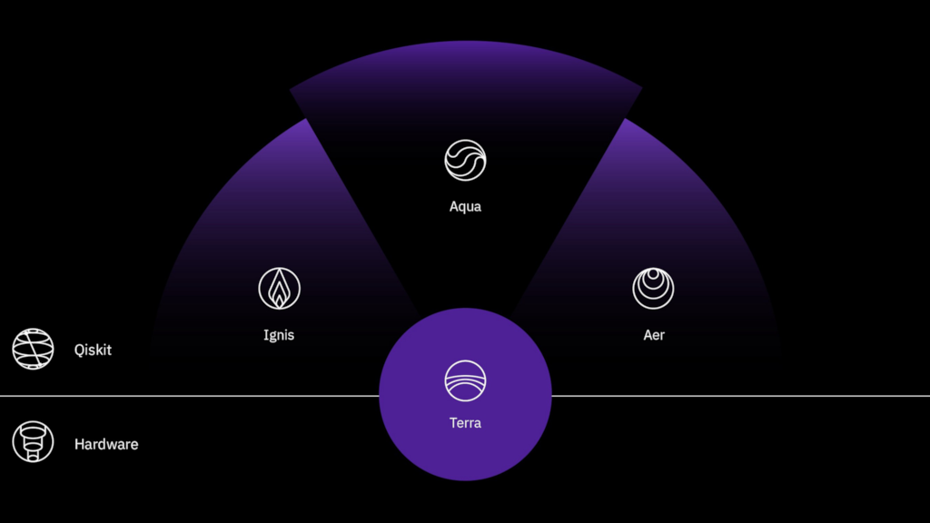
Background: Qiskit
Qiskit is the backbone of our efforts.
Open-source framework for quantum development.
Simulator
System calls

Slide 10
Primers
Before proceeding with experimentation we need to establish a knowledge base regarding the following concepts:
Qubit
Superposition
Entanglement
Interference
Quantum Gate
Quantum Circuit

Slide 11
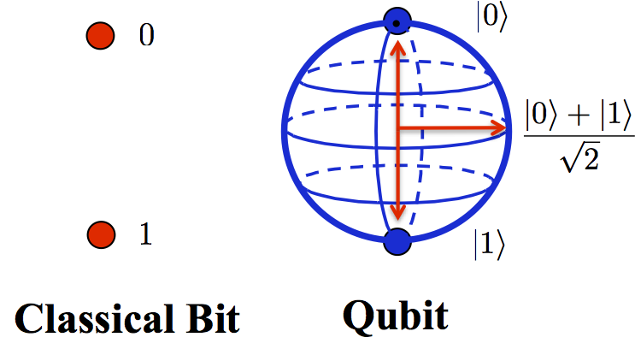
Primers - Qubit
The simplest form of information in Quantum Computing.
Different properties from a classical bit.
It can be manipulated or “rotated” to have different behaviors.

Slide 12
Primers – Qubit
Different mathematical operations performed on a Qubit can affect the Qubit or a system of Qubits.
A qubit in superposition can be in a mixture of states.
Two entangled qubits can affect the behavior of one another.
Interference is the process of manipulating superpositioned states in order to get useful outcomes. It is vital for quantum algorithms.

Slide 13
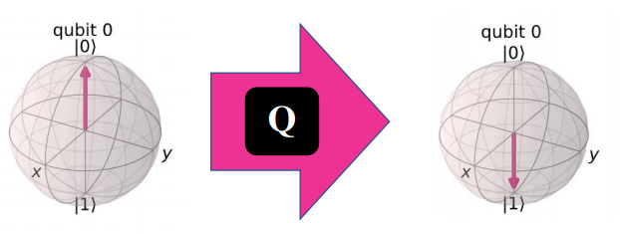



Primers – Quantum Gate
A Quantum Gate is the operation which will “rotate” the qubit to a new state.
There are many quantum gates but the ones we will use for this project are the Hadamard Gate, the X Gate and the CX or C-NOT Gate.

Slide 14
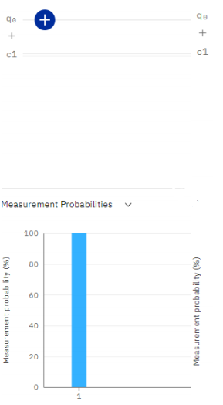
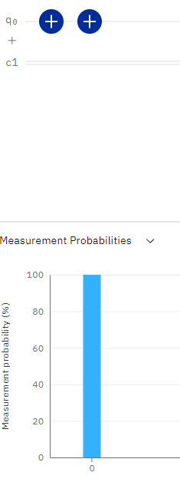
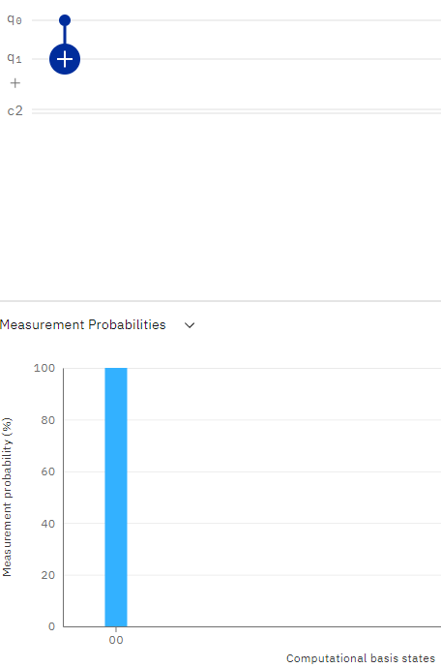
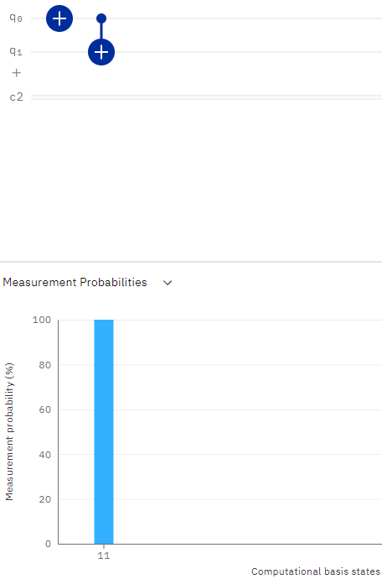
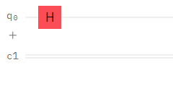
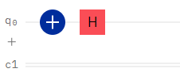
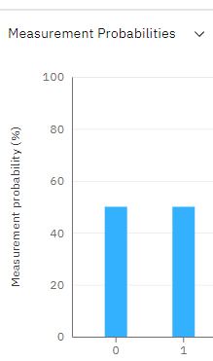
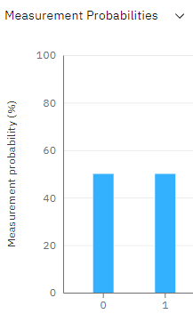
Primers – Quantum Gate Behaviors
X Gate
Behavior
C-NOT
Gate
Behavior
Hadamard Gate
Behavior

Slide 15
Quantum Circuit
A Quantum Circuit is the placeholder for these operations.
It is a model containing two registers:
A qubit register.
A bit register.
Besides Quantum Gates, classical operations can be performed here as well.

Slide 16
Presentation Outline
Introduction
Motivation – Challenges - Solution
Background
Frameworks and Qiskit
Primers
Quantum Computing Learning Gate
Level 1 – Experimenting with Primers
Level 2 – The Exciting Game
Level 3 – Implementation of Algorithms
Level 4 – Evaluation of Algorithms
Conclusions & Future Work

Slide 17
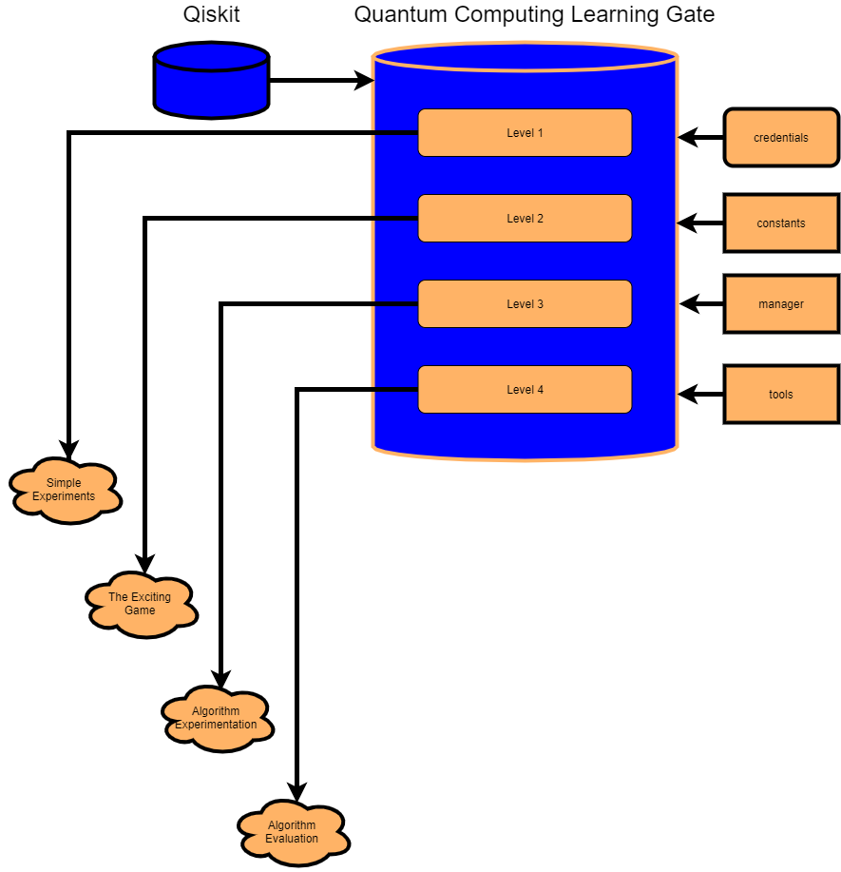
QCLG Structure

Slide 18
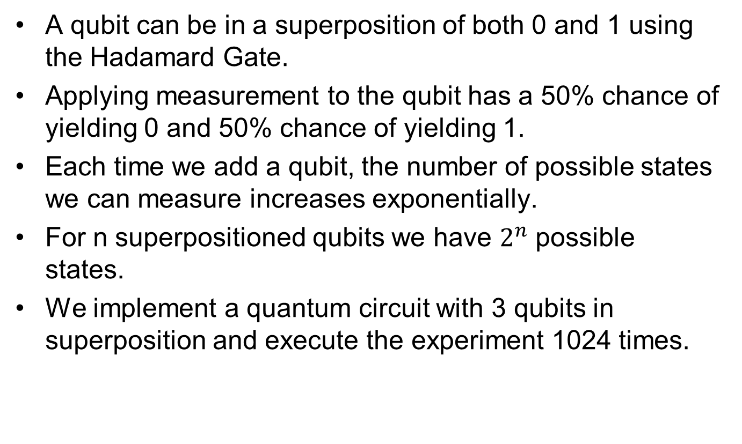
QCLG Level 1 - Superposition
A qubit can be in a superposition of both 0 and 1 using the Hadamard Gate.
Applying measurement to the qubit has a 50% chance of yielding 0 and 50% chance of yielding 1.
Each time we add a qubit, the number of possible states we can measure increases exponentially.
For n superpositioned qubits we have $2^{n}$ possible states.
We implement a quantum circuit with 3 qubits in superposition and execute the experiment 1024 times.

Slide 19
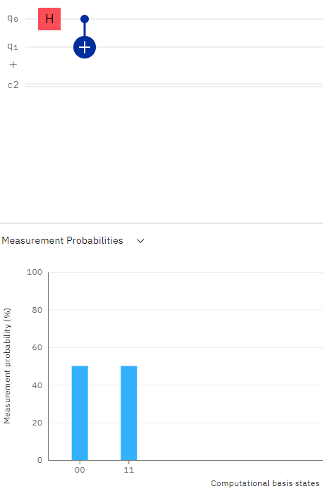
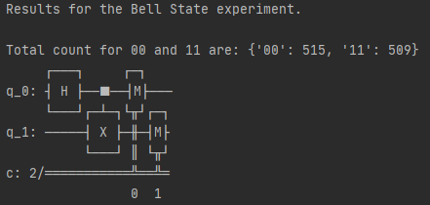
QCLG Level 1 - Entanglement
Hadamard
Gate
Qubits in entanglement have the property which allows us to confidently determine the state of a qubit if we know the state of its “neighbor” qubit.
We implement the Bell-State to demonstrate this.
It is renowned as the “Hello World” program for Quantum Computing.
C-NOT Gate
Possible States

Slide 20
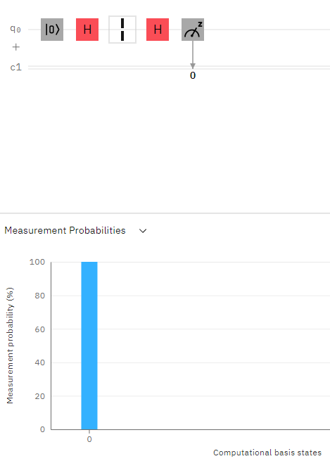
QCLG Level 1 - Interference
Qubit is in an uncertain state of both zero and one. Measuring at this point has an equal probability of yielding 1 or 0.
Interference is key to quantum algorithm development.
It shows that the randomness of a superposition is not the same as pure statistical probabilities.
This experiment demonstrates quantum interference in its purest form.
Applying a second Hadamard gate destructs the effect of the first gate, resulting in the absolute state of 0.
100% probability of measuring 0.

Slide 21
QCLG Level 2 – The Exciting Game
Two-player “card” game using Qiskit.
The quantum gates are the cards.
Both players start with a qubit in the ground state and their goal is to manipulate their qubit to transform into the excited state with a limited number of “cards”.

Slide 22
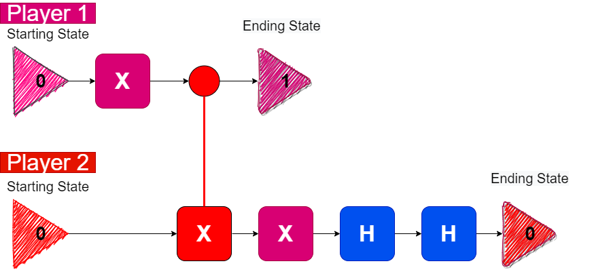
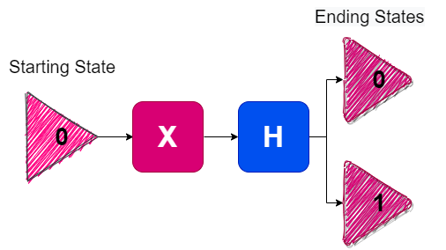
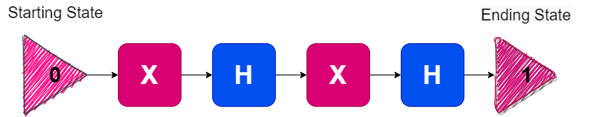
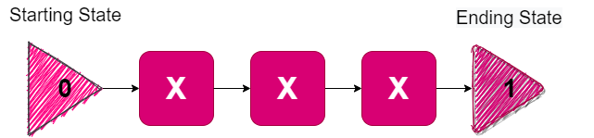
QCLG Level 2 – The Exciting Game
Entanglement
Superposition
Interference
Classical Gates

Slide 23
QCLG Level 2 – The Exciting Game
Through The Exciting Game’s game mechanics, we have demonstrated the primers in action.
Level 2 is very useful for practice.
Interactive.
Good intermediate point between levels 1 and 3.

Slide 24
CQLG Level 3
Implementation of:
Deutsch-Jozsa.
Bernstein-Vazirani.
Implement each algorithm using classical logic.
Implement each algorithm using quantum logic.

Slide 25
Deutsch-Jozsa
Determine if a given function is either:
Balanced.
Constant.
balanced: f(0) = 0, f(1) = 1
balanced: f(0) = 1, f(1) = 0 constant: f(0) = 0, f(1) = 0 constant: f(0) = 1, f(1) = 1

Slide 26
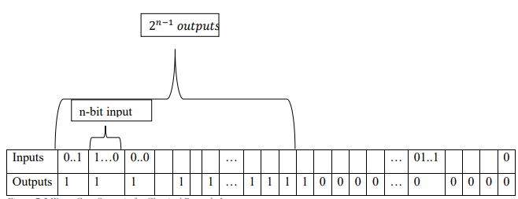
Deutsch-Jozsa Classical Approach
We will determine whether the XOR operation for n bits is a balanced function.
To determine if a function if balanced we need to get both 0 and 1 as answers.
If the input is given randomly, execution times may vary.
We created a fixed input scheme to have consistent execution times as the input size increases.

Slide 27
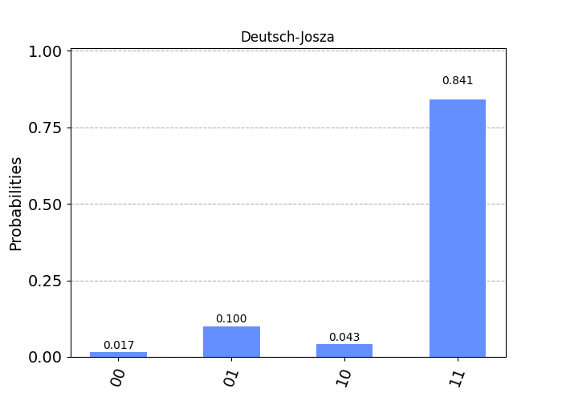
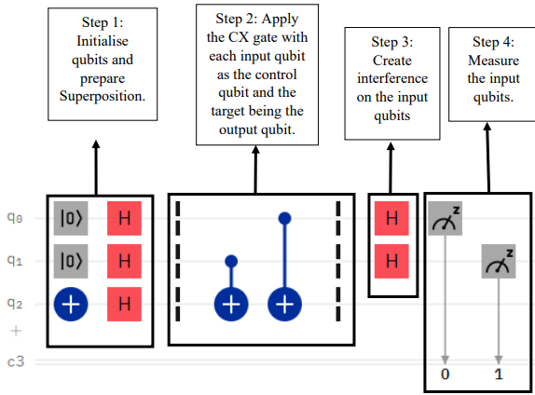
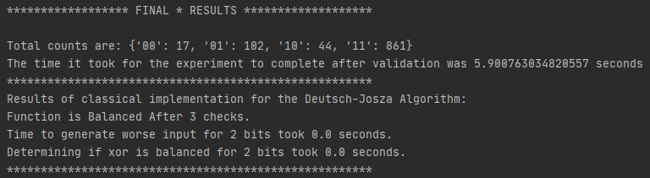
Deutsch-Jozsa Quantum Approach
The Quantum Gate equivalent to XOR is the CX Gate, which has a control qubit and a target qubit. If the control qubit is 1, then the target qubit will be flipped.
Our goal is to show that the CX operation is a balanced function.
The algorithm is split in four steps.
Due to Interference, Deutsch-Jozsa dictates that the input qubits will all measure 1 for a balanced function and 0 for a constant function.

Slide 28
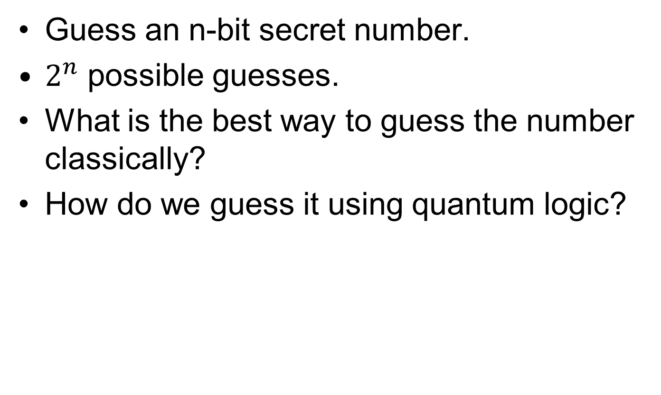
Bernstein-Vazirani
Guess an n-bit secret number.
$2^{n}$ possible guesses.
What is the best way to guess the number classically?
How do we guess it using quantum logic?

Slide 29
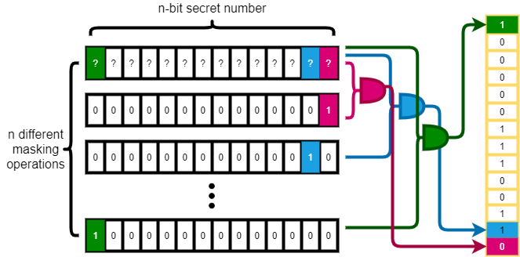
Bernstein-Vazirani Classical Approach
Use masking.

Slide 30
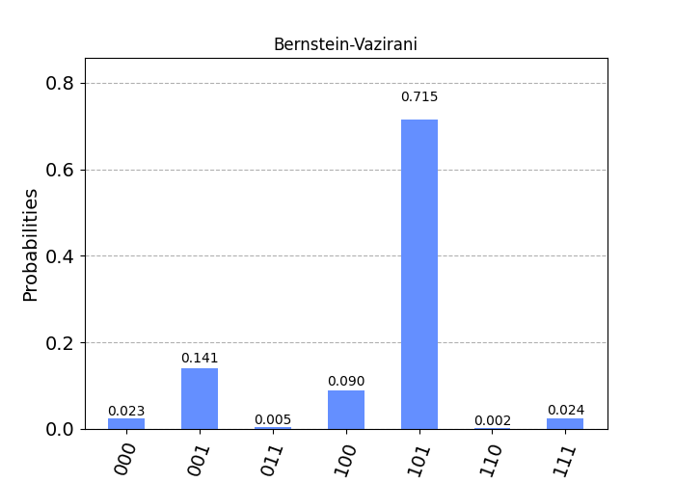
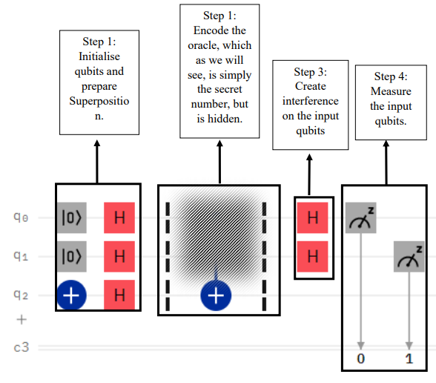
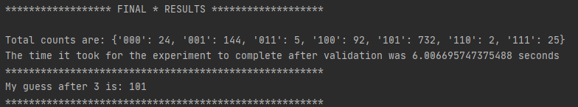
Bernstein-Vazirani Quantum Approach
The Bernstein-Vazirani quantum solution can “guess” the number in a single attempt.
The algorithm is again split in the same four steps as Deutsch-Jozsa.
Due to interference, Bernstein-Vazirani dictates that the measurement of the input qubits must be the secret number.

Slide 31
CQLG: Level 4
We automated many of the procedures of Level 3 in order to evaluate the algorithms on two bases.
Execution time.
Quantum Accuracy.

Slide 32
Evaluation Methodology
Perform an evaluation on a user-given input size range.
Execute both approaches 1024 times for each input size. We do this for two reasons:
For small inputs execution times for classical systems are too small to accurately measure.
Achieve a more realistic view of the actual accuracy of the quantum systems by executing the same circuit over and over.

Slide 33
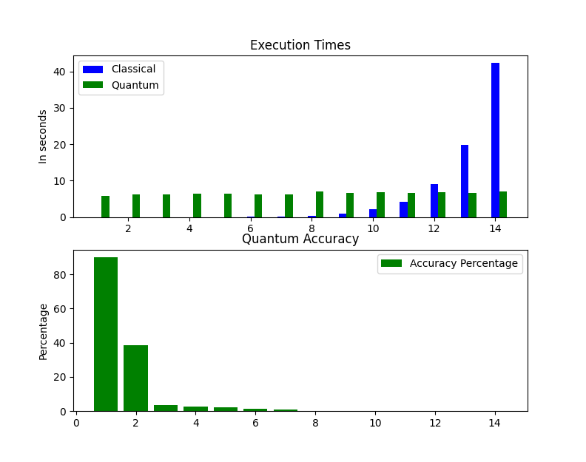
Evaluation Results for Deutsch-Jozsa

Slide 34
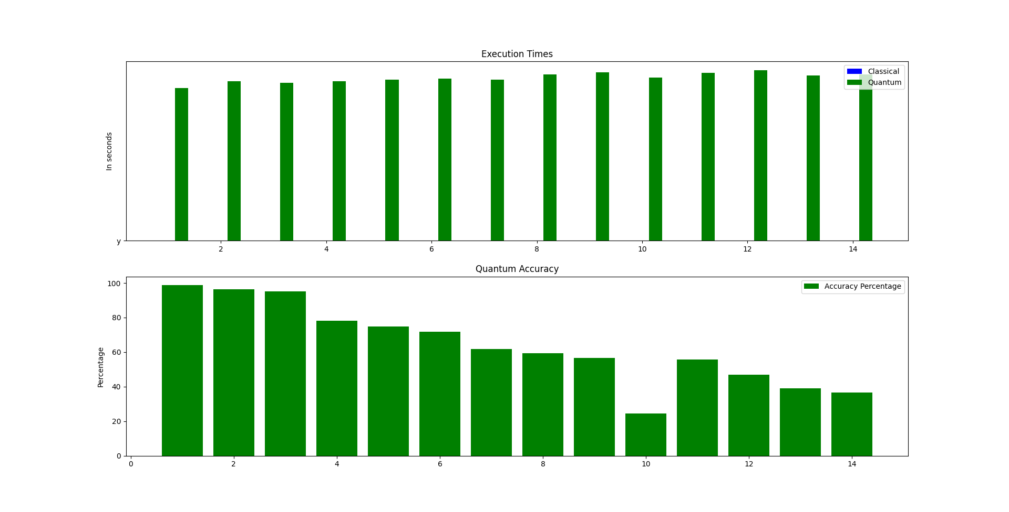
Evaluation Results for Bernstein-Vazirani

Slide 35
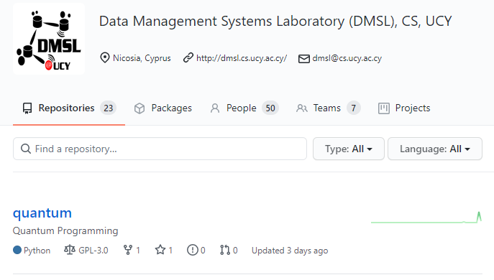
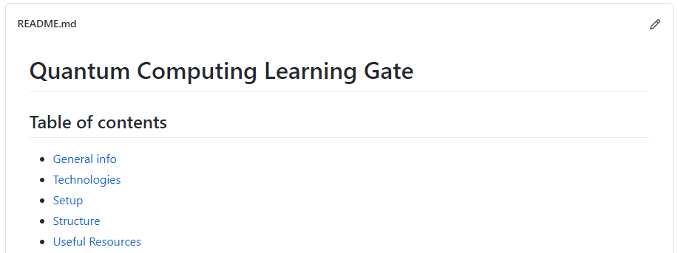
QCLG on GitHub

Slide 36
Presentation Outline
Introduction
Motivation – Challenges - Solution
Background
Frameworks and Qiskit
Primers
Quantum Computing Learning Gate
Level 1 – Experimenting with Primers
Level 2 – The Exciting Game
Level 3 – Implementation of Algorithms
Level 4 – Evaluation of Algorithms
Conclusions & Future Work

Slide 37
Conclusions
We have built a foundation for further Quantum Computing research with the implementation of the Quantum Computing Learning Gate.
Quantum Systems have a lot more room for improvement.
There is a wide variety of frameworks offering tools for advanced quantum development.
Quantum Computing can and should be a subject for larger audiences.

Slide 38
Future Work
Add more simple experiments to the first level of QCLG.
Implement and evaluate more mainstream algorithms.
Develop a graphical interface for “The Exciting Game”, which can be a standalone application.
Add a fifth level to QCLG with real-world applications.

Slide 39
Case Study of Algorithms on Classical and Quantum Computers
Thanks! Questions?
Sotiris Loizidis
University of Cyprus, Cyprus
sloizi02@cs.ucy.ac.cy
Thesis Presentation, Cyprus, January 11, 2021

